Slide 1
McKinnon update

Slide 2

Internal report content

Slide 3
What has happened to Federal Spending?

Slide 4
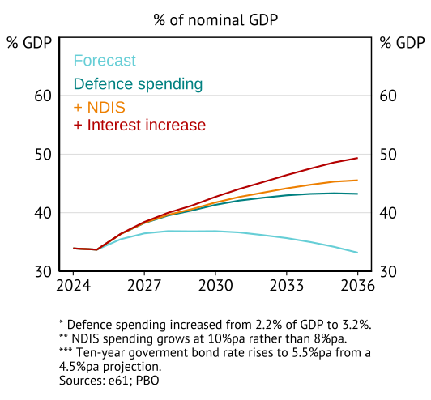
What are some key spending risks

Slide 5
Extended spending work

Slide 6
Topics
There are three measurement and communication areas where additional work could improve understanding of fiscal pressures.
Consolidation – taking an all of government approach to spending on functions
Benchmarking – international and demographic based benchmarks
Tracking – how do we interpret, communicate, and update the above insights.
Work on short-termism is within a separate, but related, stream – Kizzy and Michael are leading this directly.
Summary: Australia has become a high general government spending country, while using a tax and transfer system built for a small government.

Slide 7
Consolidation
Looks like we have OECD data
Looks like we can request ABS data (made a fairly detailed request, waiting to hear back).
Consolidation
GFS accounts – publicly available, tell us about nature of costs, nothing on functions (i.e. health)
COFOG – use based on function, allows us to understand disaggregated trends.

Slide 8
What does consolidation tell us?
In General Spending
Consolidated government spending was 37% of GDP in XXX (compared to X% at the Federal level).
In deficit terms
XXX
Notes:
Goal is to attribute functions funded by Federal government but undertaken by State government to a shared account – Federal revenue and expenses are both increased by GST, but given the nature of how it is provided unconsolidated balance sheets don’t tell us the exact function that this activity is always supporting. The purpose of consolidation is to look through this.

Slide 9
What does consolidation tell us?
In the GFS (inputs)
XXX

Slide 10
What does consolidation tell us?
By function/use
XXX

Slide 11
Benchmarking
International
OECD division COFOG data.
Synthetic control exercise to benchmark against “similar” countries.
Adjusted expenditures
Disaggregated COFOG
Use demographic and economic factors to build benchmarks.

Slide 12
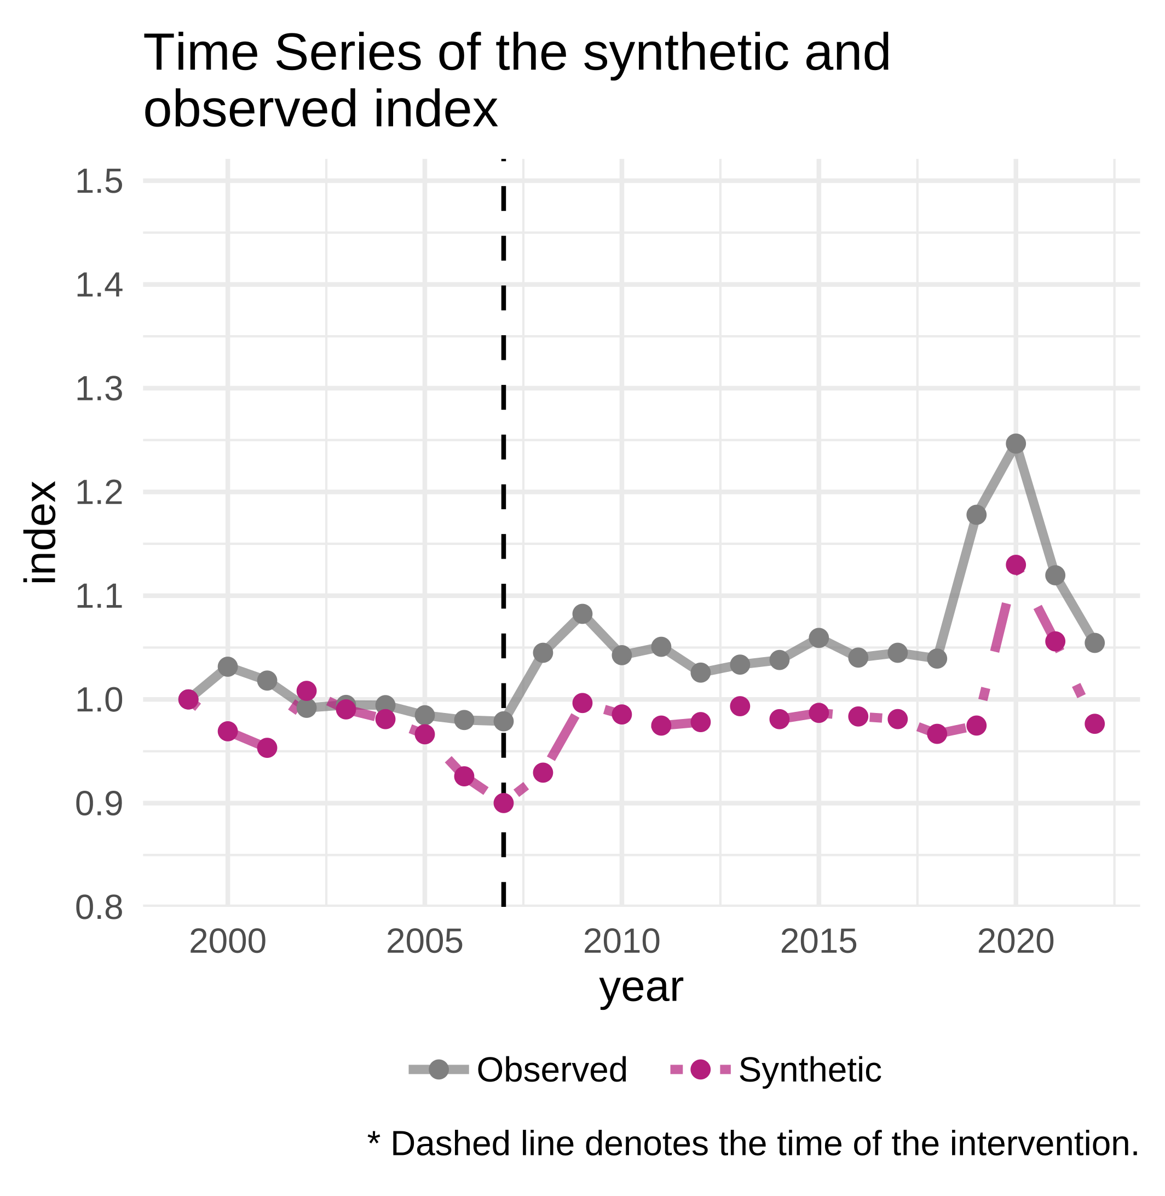
International Benchmarking
Synthetic control exercise on overall spending
Relative to countries with similar E/GDP ratio movements prior to the GFC, Australia has risen.
Something (after adjustments)
Key question is what has driven this.

Slide 13
International Function Benchmarking
Synthetic control exercise on overall spending
Relative to countries with similar E/GDP ratio movements prior to the GFC, Australia has risen.
Something (after adjustments)
Key question is what has driven this.

Slide 14
Forecast Function benchmarking
Relative to forecasts
Decisions made will typically ensure that spending exceeds projections – especially given the conservative spending allowance.
Take projections.
Add:
Share of CSA
[any other amount to add]
This provides the benchmark by function provided.

Slide 15
Demographic Functional Benchmarking
Sector stuff
Synthetic control exercise on overall spending
Relative to countries with similar E/GDP ratio movements prior to the GFC, Australia has risen.
Something (after adjustments)
Key question is what has driven this.

Slide 16
Input costs
Check if we can find international IFRS GFS type standards to compare types of inputs used.

Slide 17
Tracking and projections
Adjusted expenditures

